Slide 1
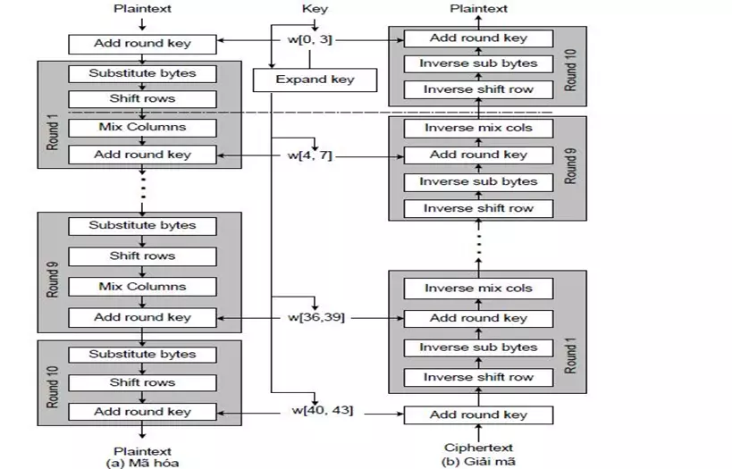
a. Encryption
b. Decryption

